Slide 1

Line Follower Robot
(& IR Remote)
Alexandru Grigoraș
Faculty of Automatic Control and Computer Engineeering - Iași
Alexandru Ioan Acălfoaie
Faculty de Electronics, Telecomunications and Information Technology - Iași

Slide 2
Summary
General Description
Hardware
Software
Use cases and future development
References
Electrical Scheme
Components
PCB Building / Chassis Design
PID Algorithm
Algorithm

Slide 3
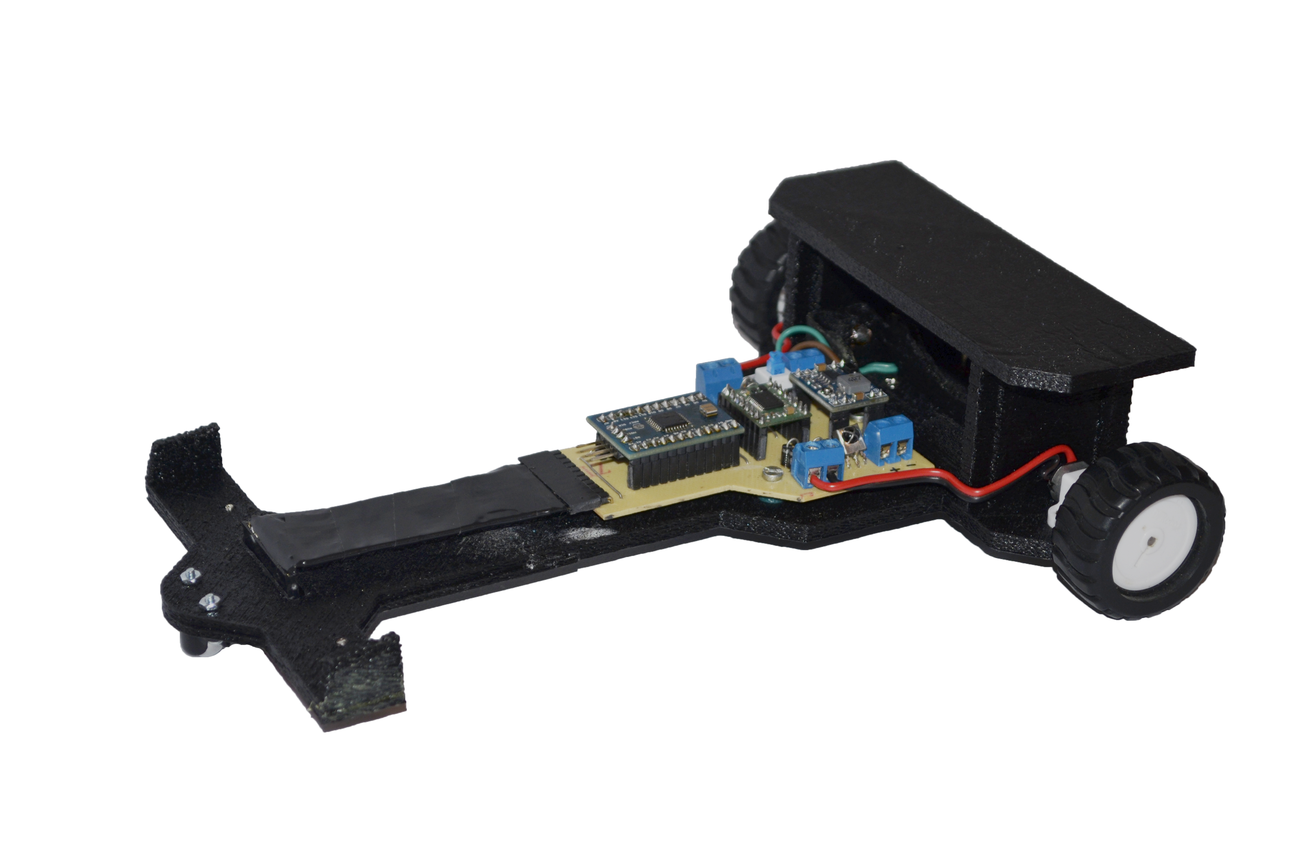
General Description

Slide 4
Electrical Scheme
Motor
1
Senzors
Motor
Driver
Reduino
Motor
2
5V
Battery
7,4V
Step-Down

Slide 5
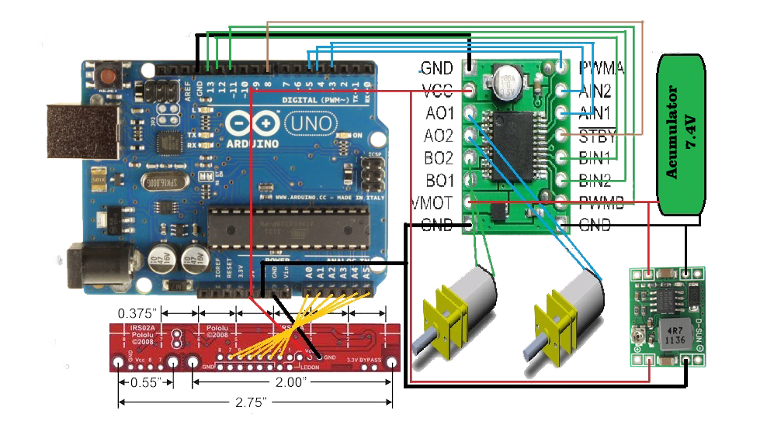
Electrical Scheme

Slide 6
Components
Reduino Core
Step-down MP1584
Motor Driver TB6612FNG Dual 1A
Digital line sensors QTR-8RC
Electric Motor Micro Metal 50:1 HP
2 18650 Battery cells
Ball Caster
Other components: 1N4004 diode, LEDs, 220Ω resistors, 100nF capacitors, micro-switch, connectors

Slide 7
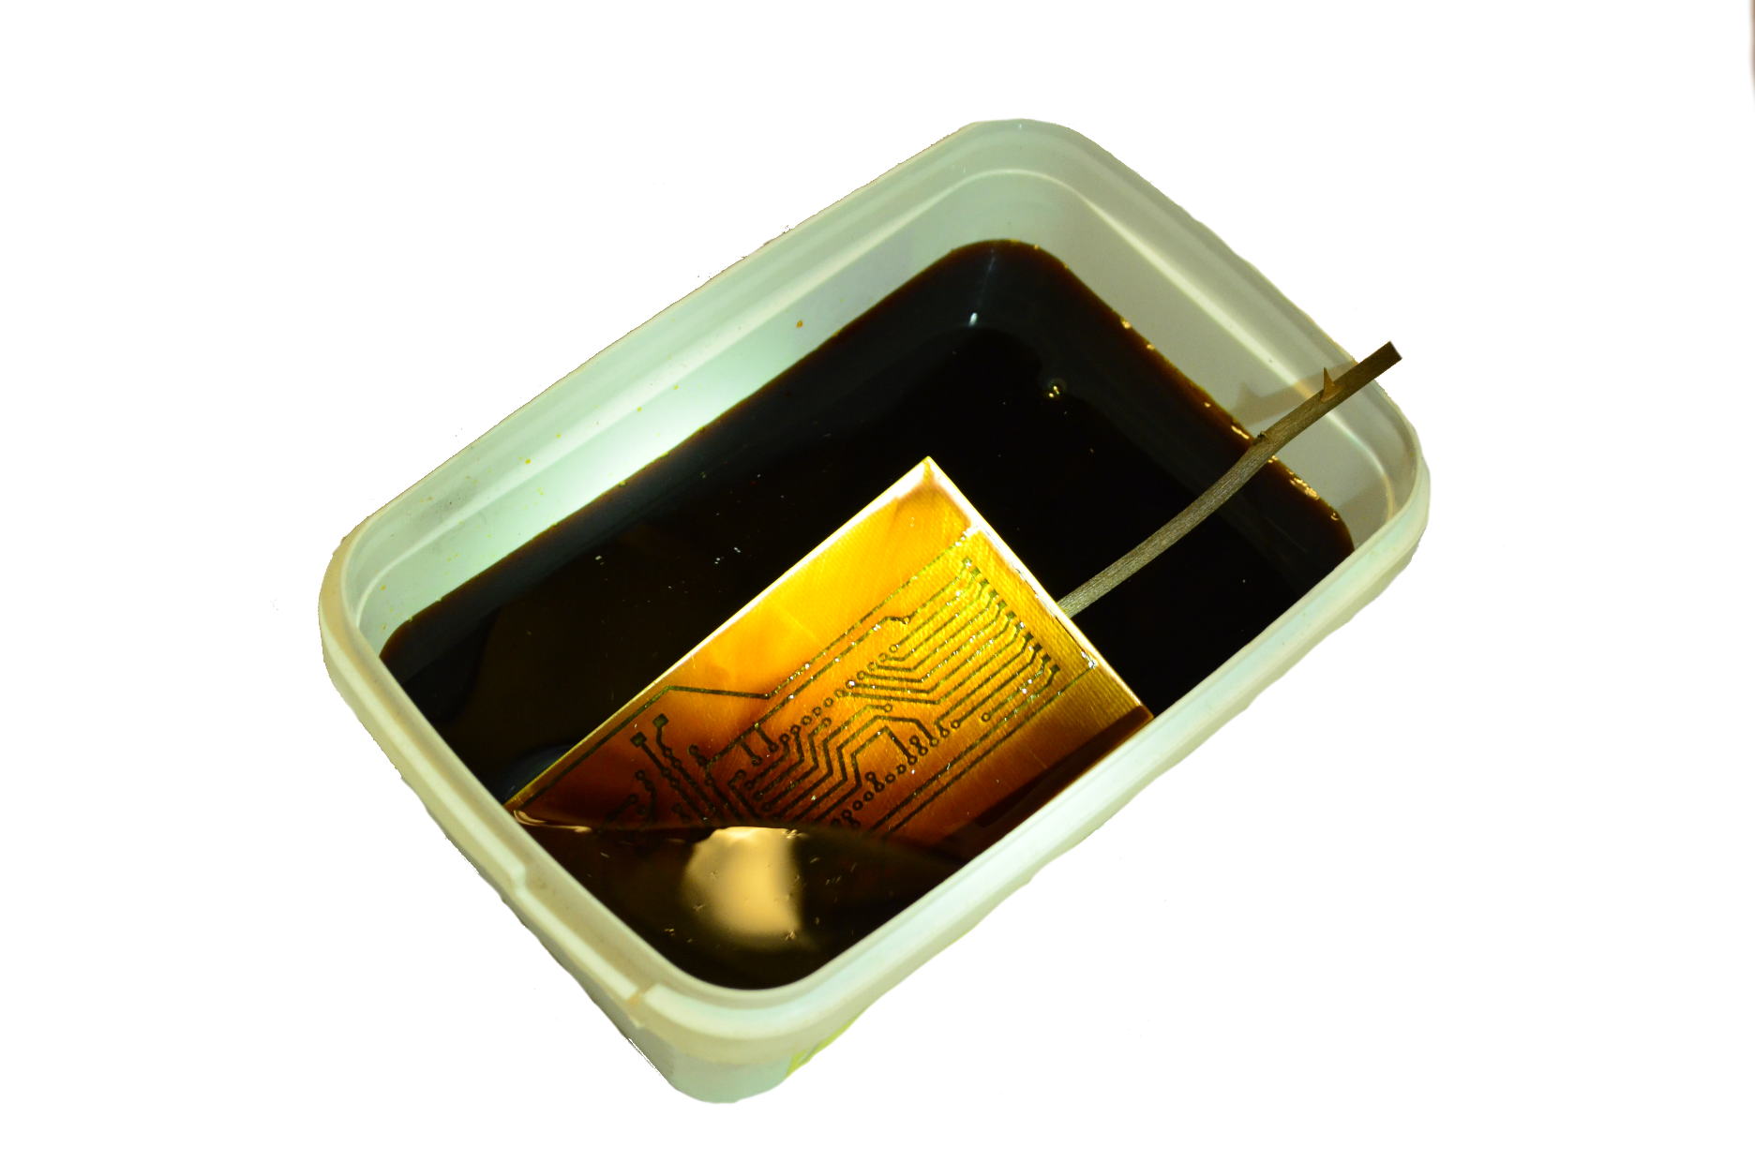
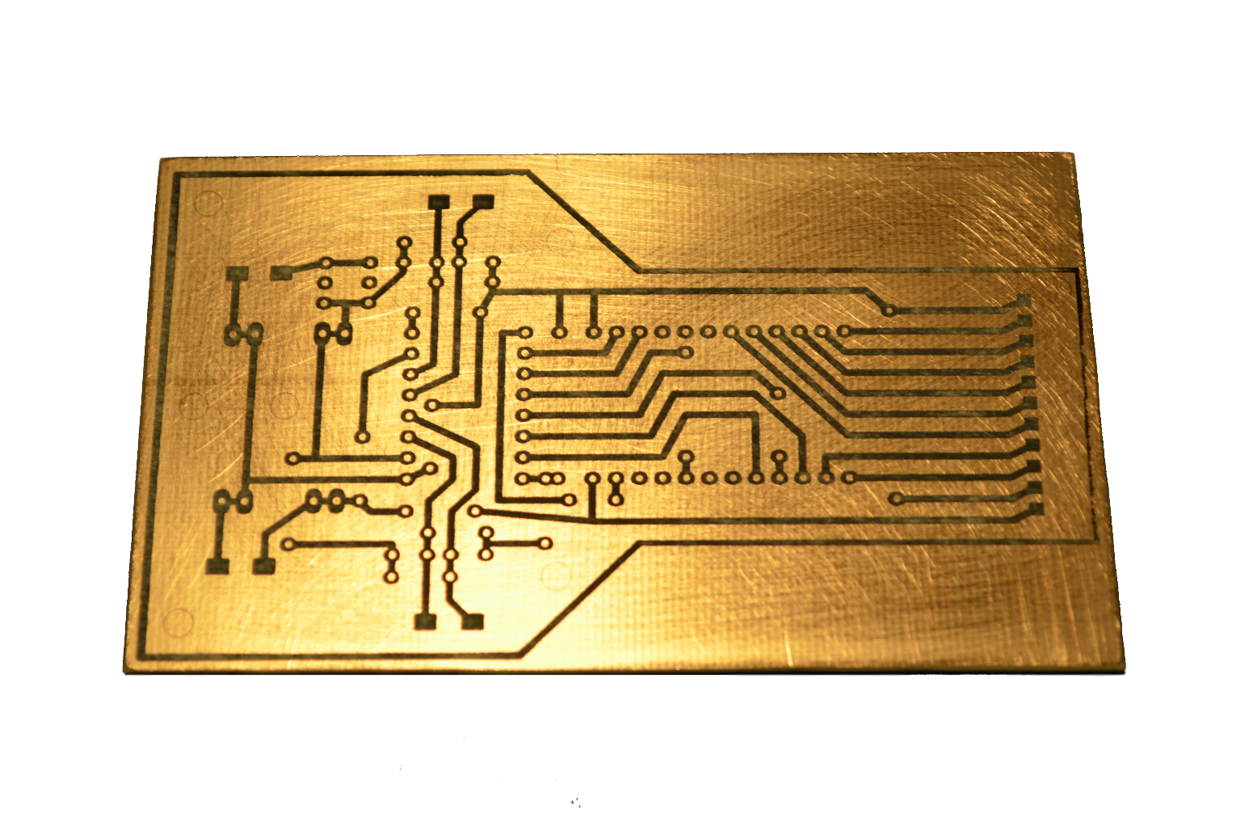
PCB Building

Slide 8
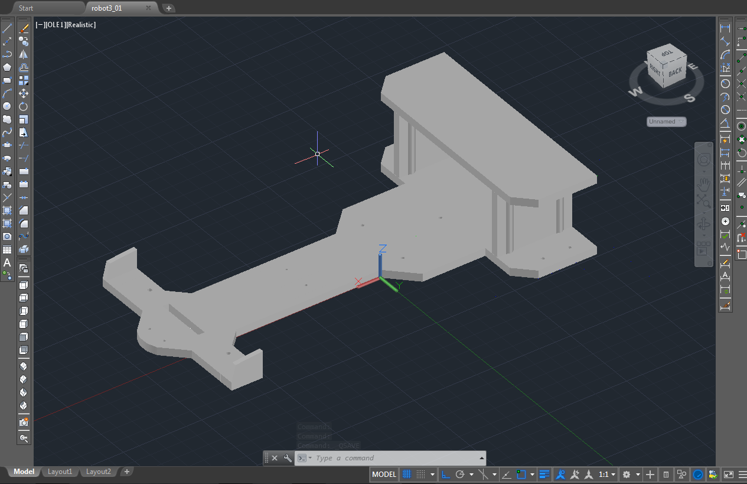
Chassis design

Slide 9
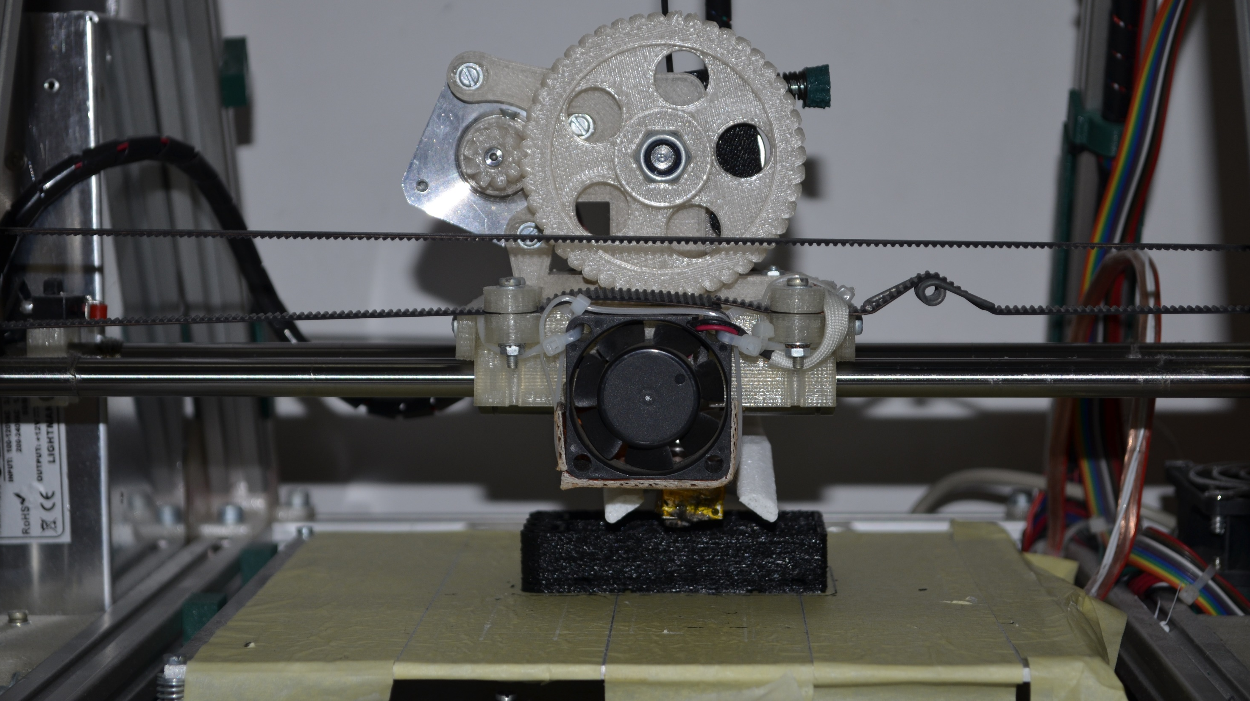
3D Printing

Slide 10
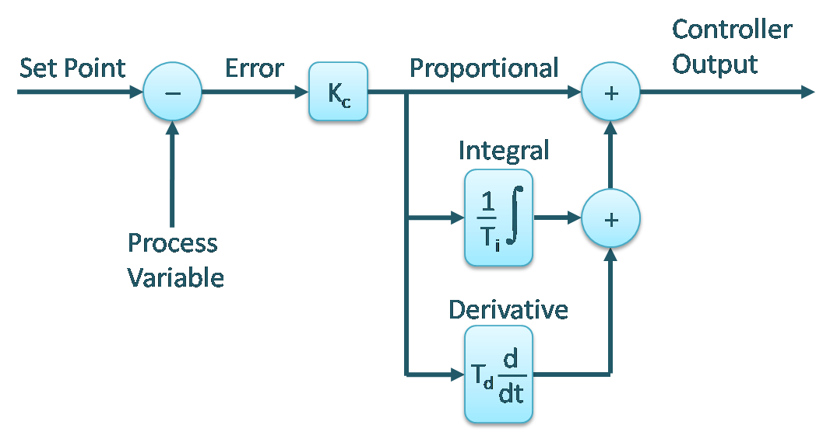
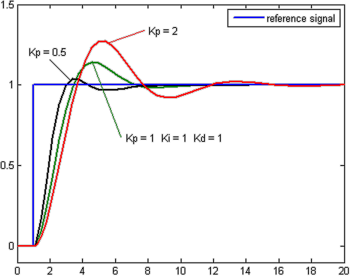
PID Algorithm

Slide 11
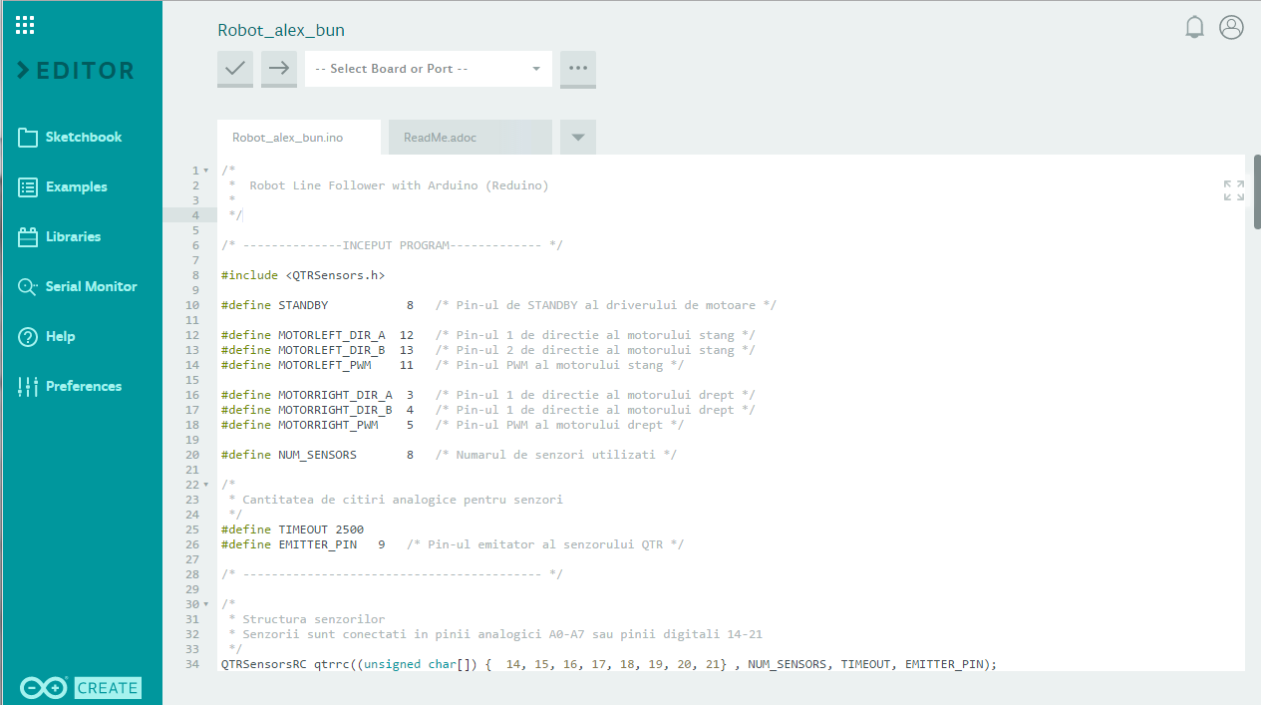
Algorithm

Slide 12
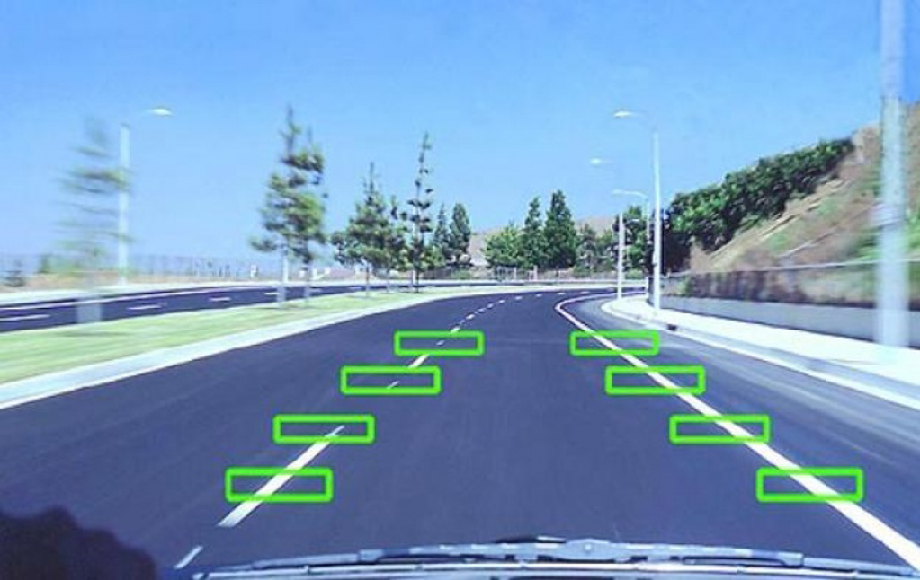
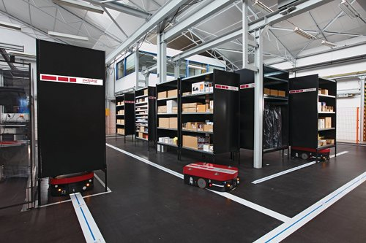
Use cases and future development
Automotive – autonomous driving
Industry – warehouse robots

Slide 13


Slide 14
References
https://www.robofun.ro/reduino-core?search=reduino
https://www.robofun.ro/bara_senzori_linie_qtr_8rc?search=qtr-8&sub_category=true
https://www.optimusdigital.ro/motoare-micro-motoare-cu-reductor/679-micro-motor-cu-reductor-ga12-n20-150.html?search_query=micro+moto&results=43
www.mivarom.ro
http://letsmakerobots.com/node/39829
https://en.wikipedia.org/wiki/PID_controller
http://webdelcire.com/wordpress/archives/619

